Slide 1
Data Science Lab – SoSe 2019
Project Title - Forecasting Refugee Inflow Using UNHCR Dataset
15/07/2019
1

Slide 2
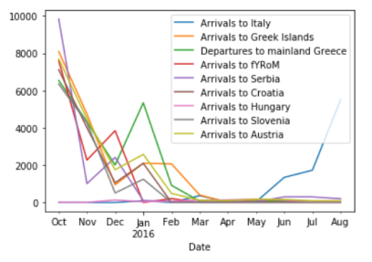
Overview of the dataset
The dataset is regarding the movement of refugees through the Balkan route.
The dataset has information about the refugees incoming to the countries during the period from October 2015 to September 2016 for the countries:
Italy, Greek Islands, Mainland Greece, fYRoM, Serbia, Croatia, Hungary, Slovenia and Austria.
15/07/2019
2

Slide 3
Data preparation, Proposed solution and evaluation
Analysis and observations from the dataset :
1. The number of refugee inflow increased exponentially from the month of July to August.
2. For all the countries the refugee inflow is the least or near to zero during the month of March till May.
3. The month of October has the maximum refugees incoming to all the countries.
15/07/2019
3

Slide 4
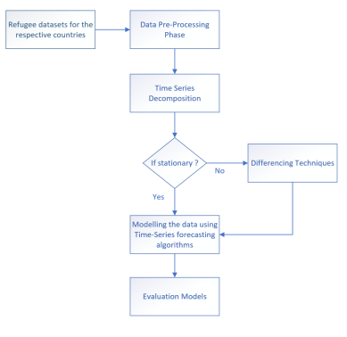
Data preparation, Proposed solution and evaluation
Workflow to be followed :
15/07/2019
4

Slide 5
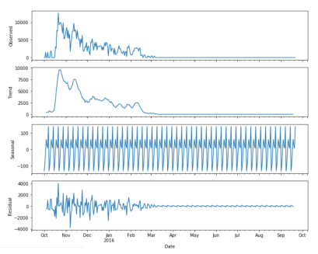
Data preparation, Proposed solution and evaluation
Components of time series:
1. Trend
2. Seasonality
3. Residual
Time Series Decomposition :
15/07/2019
5

Slide 6
Data preparation, Proposed solution and evaluation
Interpolation techniques :
1. Linear Interpolation
2. Inverse Distance Weighting
Forecasting models :
1. ARMA
2. ARIMA
3. SARIMA
Evaluation Metrics:
1. MSE, RMSE, MAS.
2. Dynamic time warping – Determination of similarity between two time series.
15/07/2019
6

Slide 7
Data preparation, Proposed solution and evaluation
Problem Statements:
1. How is the preferred destination for the refugees being affected by the changes in the total number of refugees traveling through the Western Balkan route and how closely are both the time series related to each other?
2. We would like to explore the correlation among the countries. The detailed explanation would be, for instance, if there exist a correlation between Arrivals to Greek Island and Mainland Greece during a certain period of time then would the same correlation exists in the future also.
15/07/2019
7

Slide 8
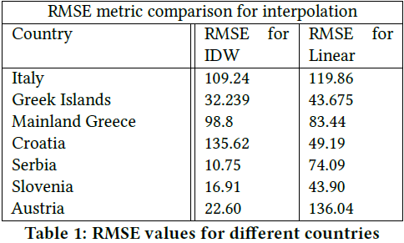
Interpolation Techniques
To fill the missing values, the interpolation techniques were used.
1. Linear interpolation.
2. Inverse Distance Weighting (IDW)
Among the two interpolation techniques employed, we found that IDW interpolation is performing better in terms of accuracy.

Slide 9
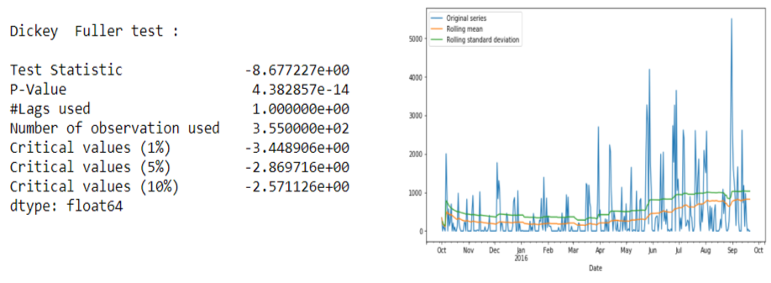
How to check whether the series in stationary?
Dickey Fuller test
Rolling Mean and Standard deviation plot
Among all the countries, we found that only the country Italy is stationary time series.
Dickey Fuller test and Rolling plot for the country Italy (Stationary series)

Slide 10
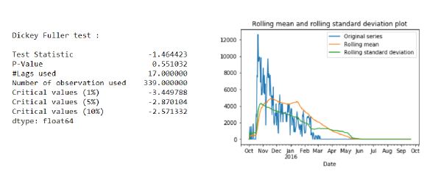
How to check whether the series in stationary?
Dickey Fuller test
Rolling Mean and Standard deviation plot
Results for the country : Slovenia
Dickey Fuller test and Rolling plot for the country Slovenia (Non-stationary series)

Slide 11
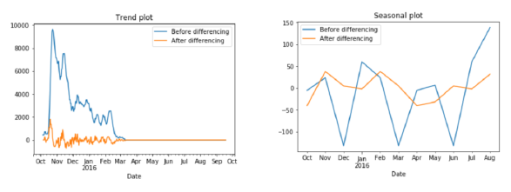
Difference Transform
Approach-1:
Step-1: Removing Trend from the non-stationary series.
Step-2: Removing Seasonality from the De-trended series.
Step-3: Applying inverse-differencing after modelling the data.
Comparison of the Trend and Seasonal plot before differencing and after differencing for Slovenia

Slide 12
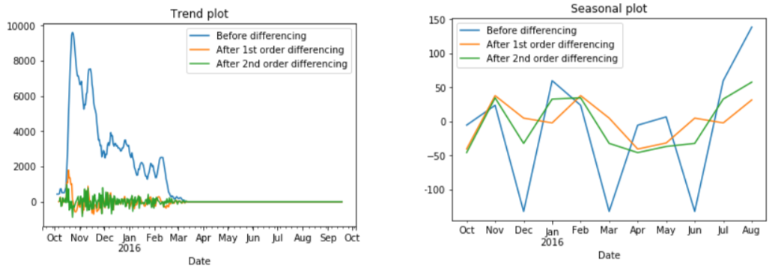
Difference Transform – cont.
No significant improvements after applying 2nd order differencing.
Comparison of the Trend and Seasonal plot of original, 1st order, 2nd order differencing for Slovenia

Slide 13
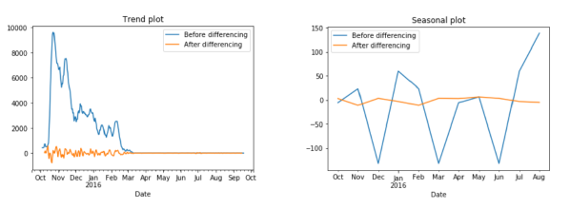
Difference Transform – cont.
Approach-2:
Step-1: Decomposing original series into trend, seasonal and residual parts.
Step-2: Extracting only residual part of the series.
Comparison of the Trend and Seasonal plot before differencing and after differencing for Slovenia

Slide 14
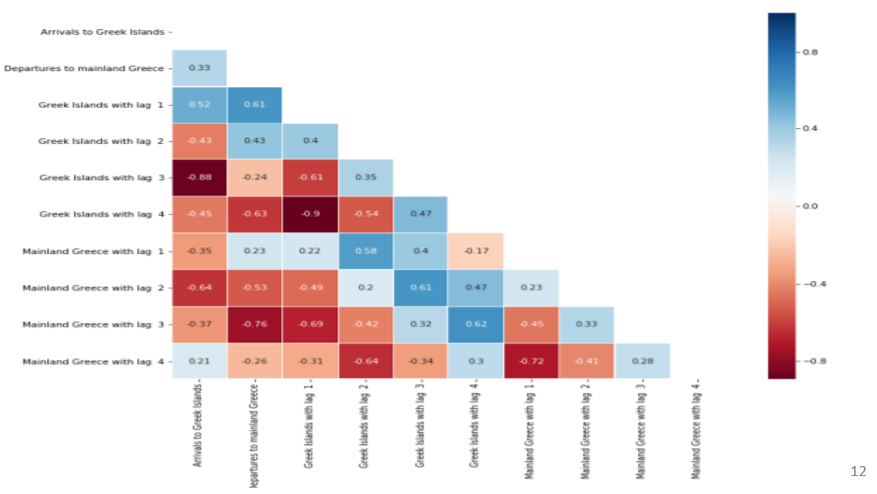
How the change of refugees in one country affects the other country?
In order to analyze if there exists any strong correlation or cross-correlation among different countries, we plotted Heat-map plot.

Slide 15
Prediction Modelling
We have used 3 different model to predict the future data.
ARIMA
ARMA
SARIMA
Used ACF & PACF plots to determine the range of AR & MA parameters.
Auto ARIMA and Grid search are used to decide upon the best set of AR, MA and I parameters for the model.
Train and test split (80:20)
Predict values using FIT model
Predict the value using Rolling window forecast method.

Slide 16
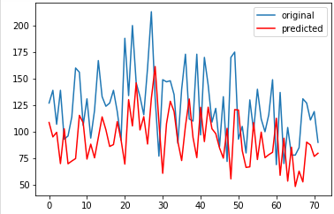
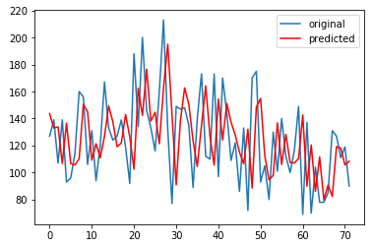
Prediction Modelling
Results.
ARIMA Forecast model SARIMA Forecast model
Predicted v/s original plot for Austria

Slide 17
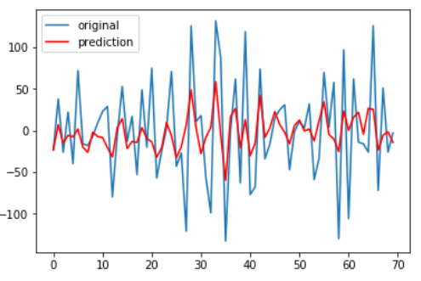
Prediction Modelling
Results of ARMA Forecast model
Predicted v/s original plot for Austria

Slide 18
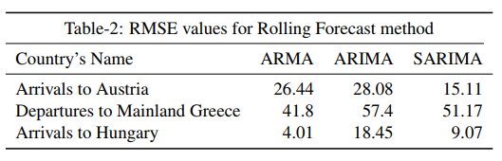
Prediction Modelling
RMSE value for all the three models:

Slide 19
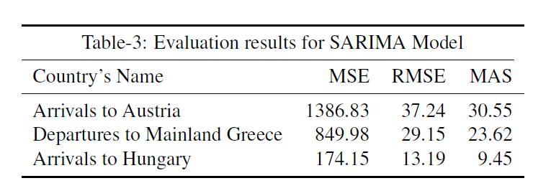
Evaluation Metrics
Mean Absolute Error (MAE)
2. Mean Square Error (MSE)
3. Room Mean Square Error (RMSE)
Results for SARIMA Model

Slide 20
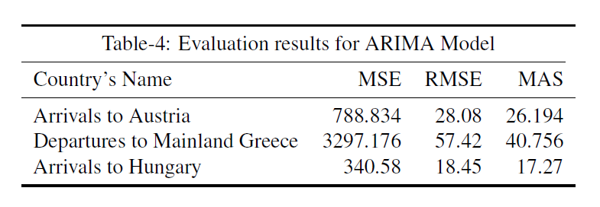
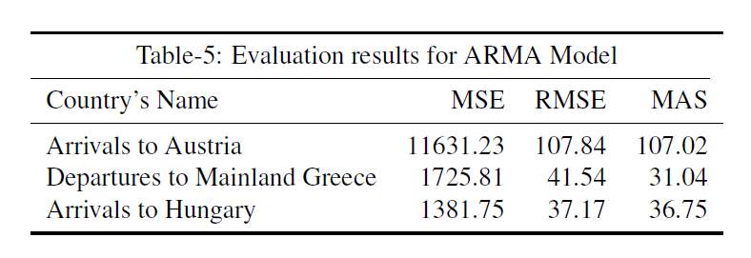
Evaluation Metrics- Results
Results for ARIMA Model
Results for ARMA Model

Slide 21
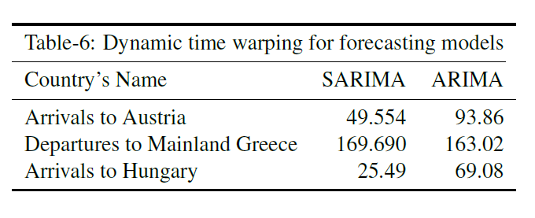
Results contd…
4. Dynamic Time Warping
Measures how similar is the original and the predicted time series while both may vary in speed.
DTW analysis shown below clearly shows that the predicted time series in the case of the SARIMA model is more similar to the actual time series as compared to other models.

Slide 22
Conclusions
First research question results
The number of refugee inflow is found to be maximum for the country of Austria.
Positive correlation of value 0.612 exists between Austria and Total Balkon Count.
Decrease in total number of refugees passing through Western Balkon affects the inflow to Austria, exists downward trend.
Correlation coefficient of the predicted values between Austria and Total Balkon count is found to be -0.049, which is negligible.
Changes in the total count across Balkan route have almost no effect on the refugees migrating to Austria
2. Second research question results
Initially Peak correlation coefficient between the two countries fYRoM and Serbia was 0.877.
For future predicted values, maximum correlation coefficient value of 0.997 exhibits between countries serbia and Croatia

Slide 23
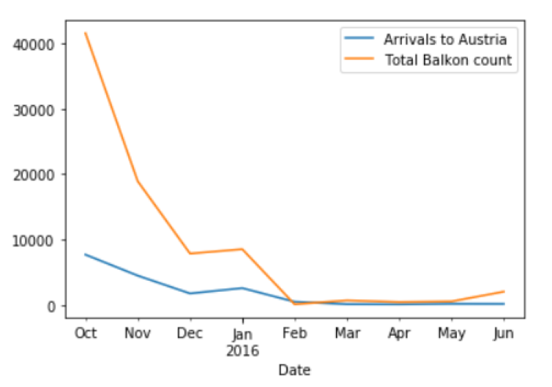
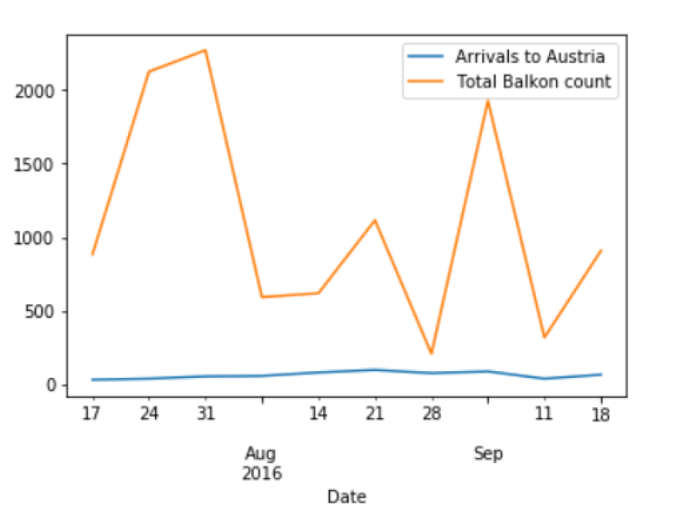
Conclusions
Plot between Austria & Total Balkan count for the original data
Weekly plot between Austria & Total Balkan count for the predicted data

Slide 24
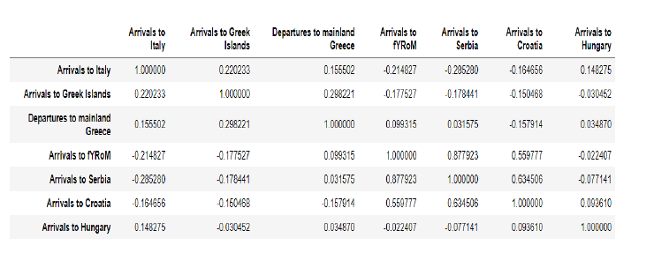
Conclusions
Corelation between countries with original data.

Slide 25
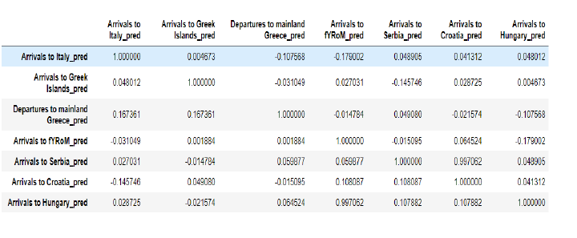
Conclusions
Corelation between contries with predicted values.

